Slide 1
Effects of Hurricane Maria on Puerto Rico
Student’s Name
Institutional Affiliations
Date
Notes:
This presentation will focus Hurricane’s Maria’s effect on Puerto Rico.

Slide 2
Introduction
Hurricane Maria was the worst tornado to occur in Puerto Rico for over eighty years ago
The geographic location of Puerto Rico is a spot for hurricanes
Mass property destructions, as well as the loss of lives, were among the effects
Although majority of citizens are trying to recover, they need more support
There was no electricity in all parts of the Island
Notes:
Hurricane Maria is considered to be the worst storm that ever happened in Puerto Rico for more than eighty years ago. Several hurricanes have occurred, but they do not cause extreme damage as the one created by hurricane Maria. Notably, the geographic location of Puerto Rico also is a spot for hurricanes and thus increasing the chances for tornadoes. The presentation will focus on the effects of Hurricane Maria on Puerto Rico, which resulted in property destruction, loss of lives, migrations of people, and the loss of electricity. Although many people struggle to recover from the hurricane, they still do not have the resources and finance needed to fix things.

Slide 3
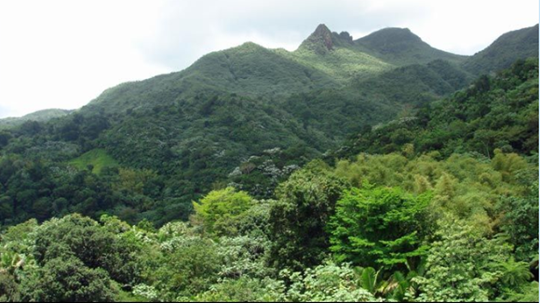
The natural Position of Puerto Rico
Situated in the northeast Caribbean Sea
The location makes it a hurricane spot (Munoz-Sola, 1987)
Is a precipitous island
More valleys are in the Island
Notes:
The topographic location of Puerto Rico favors hurricanes occurrence during the hurricanes season because it is situated in the northeast Caribbean Sea. Furthermore, the location experience the despicable hurricanes due to humid tornados form in the west Africa and Northeast trade winds blow the hurricane east on the way to America. According to Munoz-Sola (1987), Puerto Rico is among the mountainous highlands; thus, when the hurricane was coming near Puerto Rico, its liveliness was starting to reduce. However, because the tornado has a conventional eye as it passes over the mountain ranges, it bounces around, making it to be more dangerous and destructive. Additionally, the valleys also acted as channels for wind and thus increasing the speed which augmented the hurricane.

Slide 4
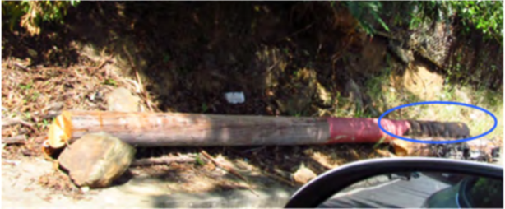
Effects of Hurricane Maria on Electricity
Electricity was destroyed
3.4 million people left without power (Kwasinski et al., 2019)
The generation of power was affected, including renewable sources of energy
Power transmission lines damaged
Poles for distribution also damaged
Notes:
Electricity was among the worst affected sector in Puerto Rico by Hurricane Maria. The power infrastructure was affected because the system was damaged severely by floods and thus were out of power for three days. 3.4 million people in Puerto Rico were without power because the generation of power reduced since some power plants had flooded (Kwasinski et al., 2019). Similarly, the transmission lines were affected by the hurricane, and nearly all transmission lines on the eastern side of Puerto Rico were destroyed. Finally, the power distribution channel was destroyed, including almost ten percent of the poles being affected. Many poles were changed, both concrete and wooden poles.

Slide 5
Economic Effects
Hurricane Maria led to losses of $43 billion (Meléndez & Hinojosa, 2017)
The estimates are based on insurance finances and storm recovery
The damages encountered were assessed and valued to be $100 billion (Meléndez & Hinojosa, 2017)
The economic impact is expected to be felt for a longer time
The private sector suffered the most with an estimate of $30 billion (Meléndez & Hinojosa, 2017)
Notes:
Hurricane Maria has caused a lot of economic crisis in Puerto Rico because of the increased losses caused. Many industries have incurred incredible losses on infrastructure and resources that they have invested for many years. Although the Island was having debts of $70 billion before the occurrence of hurricane maria, it led to more problems for Puerto Rico (Meléndez & Hinojosa, 2017). The damages accounted were assessed to be one hundred billion dollars. The impact is expected to be felt for a more extended period because of the finances and resources required being less. Finally, the private sector is observed to be the most affected by the hurricane, accounting for thirty billion dollars of the total loss (Meléndez & Hinojosa, 2017).

Slide 6
Economic Effects (Cont.)
Manufacturing industry reported more losses on income
Agriculture sector reported reparations on equipment and infrastructure
Puerto Rico gross domestic product reduced by eight percent due to Hurricane Maria (Hinojosa & Meléndez, 2018)
By 2018 twenty four percent of losses were covered by insurance companies, but the effects of reconstruction have not been felt (Hinojosa & Meléndez, 2018)
Notes:
Despite every economic sector facing challenges and experiencing extreme damages, the most affected industry is manufacturing. Manufacturing industry contributes more to the national gross domestic product and therefore, when it is affected through damage of infrastructure or lack of resources such as labor, it will be hard for them to recover. Furthermore, the population decline has increased significantly, thus making hard for the industry to recover. Agriculture was considered to be the second most affected due to destruction of equipment and infrastructure nonetheless, the damage of these industry resulted in reduction in the gross domestic product buy eight percent (Hinojosa & Meléndez, 2018). Although, by 2018, only 24 percent of the losses were covered by insurance firms the effect of reconstruction has not yet been felt (Hinojosa & Meléndez, 2018).

Slide 7
Social Effects of Hurricane Maria
Before the strike of hurricane maria Puerto Rico was experiencing an economic crisis
With more than fifty percent of the population living below poverty line (Scaramutti et al., 2019)
They import around eighty percent of their food (Scaramutti et al., 2019)
After the hurricane water and food was hard to get
Those with restored water were advised to boil as it was not safe to drink
Notes:
Hurricane Maria has resulted in increased suffering to people both as individuals and families in general. Despite working towards restructuring the Island, there are many social challenges encountered, especially for getting clean food and water for drinking. However, before the storm, Puerto Rico was already experiencing an economic decline because more than fifty of their population were living in poverty (Scaramutti et al., 2019). Besides, they were importing almost eighty percent of their foods and fuel supplies (Scaramutti et al., 2019). Nonetheless, after hurricane clean food and water were hard to find because of the destructions made. Similarly, many citizens could not access groceries and fresh food.

Slide 8
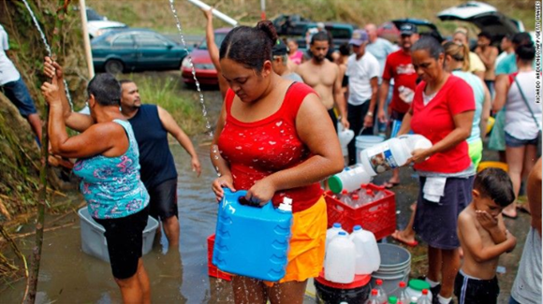
Social Effects (Cont.)
Increased suffering in families
Individuals depend on relief food from FEMA and Red Cross (Scaramutti et al., 2019)
Loss of lives by hurricane Maria and other health difficulties (Scaramutti et al., 2019)
Notes:
Water and food are very important in life; many people were subjected to suffering from hunger as well as thirst due to difficulty of getting such basic wants. Besides, the challenges of getting fresh food and clean water resulted in citizens depending on aid organizations such as FEMA and Red cross and come to their rescue. According to Scaramutti et al. (2019), lack of food and water resulted in increased health problems that could cause death. For instance, people were subjected to mental health conditions that results in unhealthy behaviors such as suicide thus leading to loss of loved ones (Scaramutti et al., 2019). Several suicide cases have been reported while the need for mental health services required since the hurricane happened.

Slide 9
Hurricane Maria and Migration
The storm triggered movement of people to United States of America
As they moved to other states, never planned to return
About 150,000 individuals left the Island in 2018 (DeWaard et al., 2020)
Around 12000 children from the Island were enrolled in schools in Florida between 2017 and 2018 (DeWaard et al., 2020)
Notes:
With the struck of hurricane Maria many citizens of Puerto Rico decided to shift to other regions and states in the United States. The storm triggered migration that resulted in decline of people on the Island. Furthermore, as many individuals move to other states, majority of them do not have plans to come back to Puerto Rico because of fear of another hurricane. Currently, it is estimated that around fifteen thousand individuals left the Island in the year 2018. Compared to the previous years approximately 90, 0000 Puerto Ricans moves to the United States each year (DeWaard et al., 2020). Similarly, according to DeWaard et al. (2020), nearly twelve thousand children were admitted to Florida schools between the years 2017 and 2018.

Slide 10
Most Affected Group
The hurricane unduly affected the deprived population
Majority of this population stay in rural areas
Children are also susceptible to psychological effects (Scaramutti et al., 2019)
Notes:
As hurricane Maria struck Puerto Rico, there are populations which were affected the most. For instance, the poor were among the most unduly affected because they have less resources available to assist them recover, and reconstruct. Moreover, majority of these individuals stay in rural areas which makes it a challenge to access clean water as well as they were the last to be restore electricity. Also, young individual and children as susceptible to psychological effects brought by the hurricane because of the fear instilled in them by the storm (Scaramutti et al., 2019). Furthermore, they also suffer because of fear of their lives and lack of good housing as they were damaged by the storm.

Slide 11
Conclusion
Hurricane Maria was the worst storm that happened in Puerto Rico
Puerto Rico’s topographic location favors heavy storms
The hurricane resulted in damage of properties such as people’s houses
A loss of $43 billion was accounted in Puerto Rico
Power grid damaged completely
Children and poor people affected the most
Notes:
The occurrence of hurricane Maria in Puerto Rico was the worst storm that ever stricken the Island for more than eighty years. However, the location of the Island makes it be a hurricane hotspot as well as the features available such as mountains and valleys which results in increased damages incase of the storm occurrence. Many properties were destroyed accounting for a loss of $43 billion in both private and public sector. Nonetheless, with just twenty-four percent of the losses being recovered by insurance firms there is still need for support to reconstruct the Island. Furthermore, the power grid was destroyed completely from electricity generation to distribution. The people affected the most were children and poor population because of the inability to get resource to rebuild as well as living in rural areas that are challenging to reach.

Slide 12
References
DeWaard, J., Johnson, J. E., & Whitaker, S. D. (2020). Out-migration from and return migration to Puerto Rico after Hurricane Maria: evidence from the consumer credit panel. Population and Environment, 1-15.
Hinojosa, J., & Meléndez, E. (2018). Puerto Rican exodus: One year since Hurricane Maria. Center for Puerto Rican Studies.
Kwasinski, A., Andrade, F., Castro-Sitiriche, M. J., & O’Neill-Carrillo, E. (2019). Hurricane maria effects on puerto rico electric power infrastructure. IEEE Power and Energy Technology Systems Journal, 6(1), 85-94.

Slide 13
References (Cont.)
Meléndez, E., & Hinojosa, J. (2017). Estimates of post-hurricane Maria exodus from Puerto Rico. Centro Voices.
Munoz-Sola, H. (1987). Preservation of library materials in a tropical climate: the Puerto Rican experience. Science & Technology Libraries, 7(3), 41-47.
Scaramutti, C., Salas-Wright, C. P., Vos, S. R., & Schwartz, S. J. (2019). The mental health impact of Hurricane Maria on Puerto Ricans in Puerto Rico and Florida. Disaster medicine and public health preparedness, 13(1), 24-27.

